Slide 1
Pre-Bid Conference
Janitorial Services for Ancillary Facilities
RFB No. 06126-NTT-00-GS-MA
Steve Lacasse
Sr. Procurement Specialist
September 20, 2024 at 10:30am (CT)

Slide 2

Agenda
Introductions
1
2
Disclaimer
3
NTTA Marketplace Registration
4
General Information
5
Required Forms
6
Disqualifications

Slide 3
Agenda
7
Insurance Requirements
8
Business Diversity Department
9
Scope of Work
10
Upcoming Key Dates
11
Questions and Responses
12
Adjourn

Slide 4
Introductions
NTTA Staff Representatives
  Procurement Services
    Steve Lacasse
    Mathews C. Pillai
  Business Diversity – Lewis Leonard
NTTA Key Staff – Subject Matter Experts
  Maintenance Department

Slide 5
Disclaimer
Anything stated at this pre-bid conference is not intended to change any terms and/or conditions stated in the solicitation document. Any authorized changes will be made in writing in the form of a clarification/addendum issued by the Procurement Department.

Slide 6
NTTA Marketplace

Slide 7
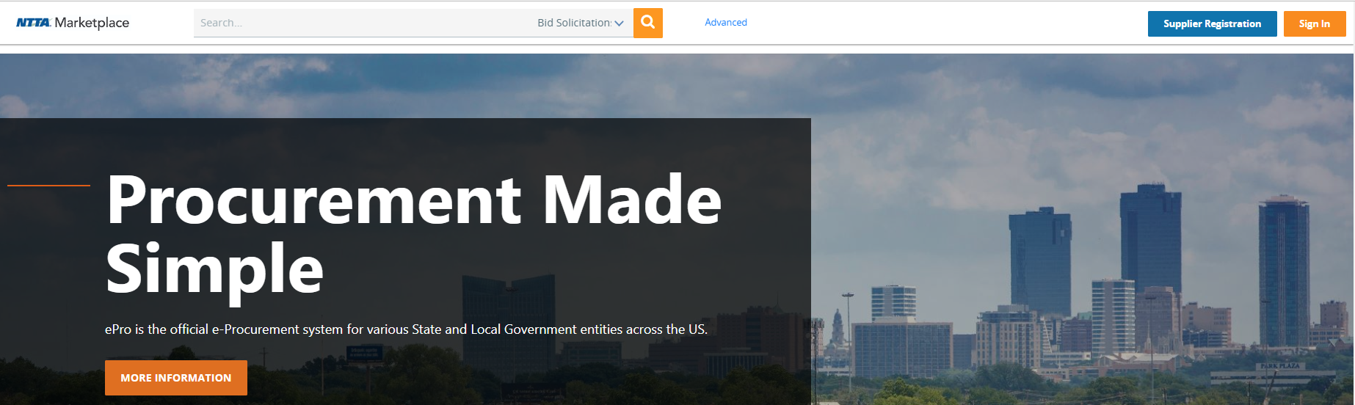
NTTA Marketplace Registration Required
nttamarketplace.org
A process guide for vendor registration is on the login page under Important Links.

Slide 8

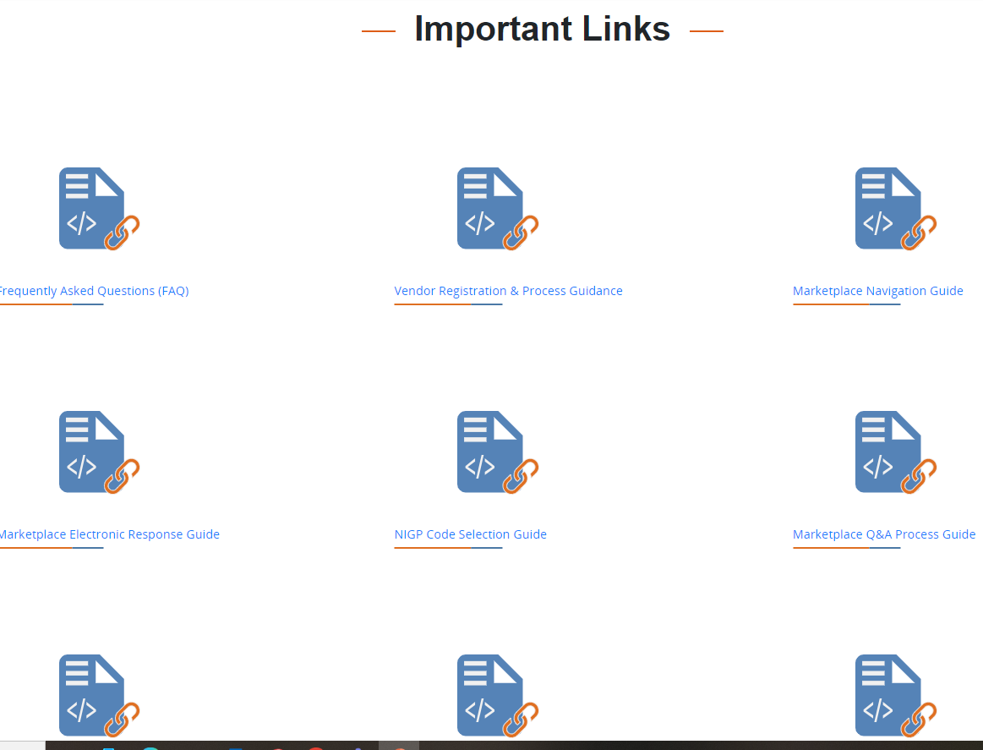
Marketplace Assistance
Registration process begins with the Register button in the top-right corner
The “Important Links” section contains guidance documents for your reference.
nttamarketplace.org
“Important Links” contains:
Registration help
NIGP code selection guidance
Site navigation assistance
Directions on submitting questions
Directions on electronic response

Slide 9
Solicitation Participation
In order to participate in a solicitation, prospective vendor must register in Marketplace
Features to having a vendor account:
Responding electronically
Submit clarifying questions
Receiving notifications of amendments
Being included on the bid holder list
Access to closed solicitations and award information
nttamarketplace.org

Slide 10
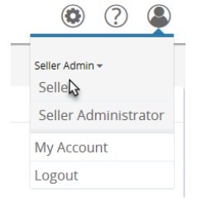
Responding Electronically
Quick Steps for Responding Electronically
Go to the “Seller” view for your vendor account
Go to the “Bids” tab and find “Open Bids”
Click the “Create Quote” link for the opportunity
You must register and log into your vendor account to respond electronically.
For more help with electronic responding, download the Marketplace Vendor Response guide from the “Attachment” tab of the solicitation.

Slide 11

General Information and Forms
Register at NTTAMarketplace.org
Read the entire Solicitation document
Acknowledge ALL Solicitation requirements
Submit your questions on the Q&A tab
All addenda must be acknowledged at time of bid due date
Submit all required forms signed in blue ink.
Registration Questions?
Email: bidpurchasing@ntta.org
Register
Notes:
Failure to register on NTTA Marketplace or if a vendor fails to acknowledge a Solicitation, the vendor cannot be considered responsive, and, is thus ineligible for a procurement award.

Slide 12
Don’t Become Non-Responsive or Disqualified!
1
Late bids will not be accepted.
This is an active Solicitation. Communication related to this Solicitation should only be with Procurement Services and Business Diversity.
2
3
Communication with anyone outside these departments is grounds for disqualification

Slide 13
Disqualifications (RFB)
A complete bid packet will include the Bid Sheet.
Alteration of the official Bid Sheet is grounds for disqualification.

Slide 14
Insurance Requirements
1
Please have your broker/insurance agent review the insurance requirements in this solicitation to make sure your company can meet or exceed the requirements.
2
A certificate of insurance will be required and reviewed for compliance prior to contract execution.

Slide 15
Insurance Requirements
3
Questions related to insurance should be submitted in writing. The written questions will be sent to the Insurance Program Administrator for response. The questions and responses will be released via addendum.

Slide 16
BUSINESS DIVERSITY

Slide 17
Business Diversity Goal
It is NTTA’s policy to promote the participation of disadvantaged, minority, woman-owned business enterprises (D/M/WBE) in the procurement of goods, materials, supplies and services on any available contracting opportunity.

Slide 18

Ensuring Active Participation
D/M/WBE
Good Faith Effort
Contract specific goals are be based on:
    scope of work, and,
    availability of certified firms
    for the scope of work
Notes:
In our determination we then set either a numerical goal or a Good Faith Effort Goal on the contract.
Specifically with the minority subcontractors you will want to ensure they are certified by one of the certifying agencies NTTA recognizes to ensure their participation counts towards the numerical goal. We will go over the certifying agencies later in the presentation. Please note you may use any subcontractor on the project but only those that hold the certification of the agencies we recognize will count towards the aspirational goal set for the project. Please complete the 4906 form in its entirety including Federal Tax ID of the firms you are utilizing, and that all parties have signed the form. MOVE TO SLIDE 4 “ BE RESPONSIVE” So How do you ensure you bid is responsive?
This particular solicitation has a NUMERICAL GOAL OF ##### OR HAS BEEN SET WITH A GOOD FAITH EFFORT. Move to the slide that it pertains to

Slide 19




Key Program Requirements
Contract-Specific Goals
Certification
DMWBE proof of certification for proposed certified subcontractors and suppliers are due at submittal of Subcontractor Plan
A percentage of the contract value to be performed by D/M/WBEs. Prime self-performance DOES not count towards goal.
Good Faith
Efforts
Reporting
Stringent documentation requirements due at submittal of Subcontractor Plan
Payments to D/M/WBEs are reported monthly by the 15th of following month in electronic diversity system
Notes:
In our determination we then set either a numerical goal or a Good Faith Effort Goal on the contract.
Specifically with the minority subcontractors you will want to ensure they are certified by one of the certifying agencies NTTA recognizes to ensure their participation counts towards the numerical goal. We will go over the certifying agencies later in the presentation. Please note you may use any subcontractor on the project but only those that hold the certification of the agencies we recognize will count towards the aspirational goal set for the project. Please complete the 4906 form in its entirety including Federal Tax ID of the firms you are utilizing, and that all parties have signed the form. MOVE TO SLIDE 4 “ BE RESPONSIVE” So How do you ensure you bid is responsive?
This particular solicitation has a NUMERICAL GOAL OF ##### OR HAS BEEN SET WITH A GOOD FAITH EFFORT. Move to the slide that it pertains to

Slide 20



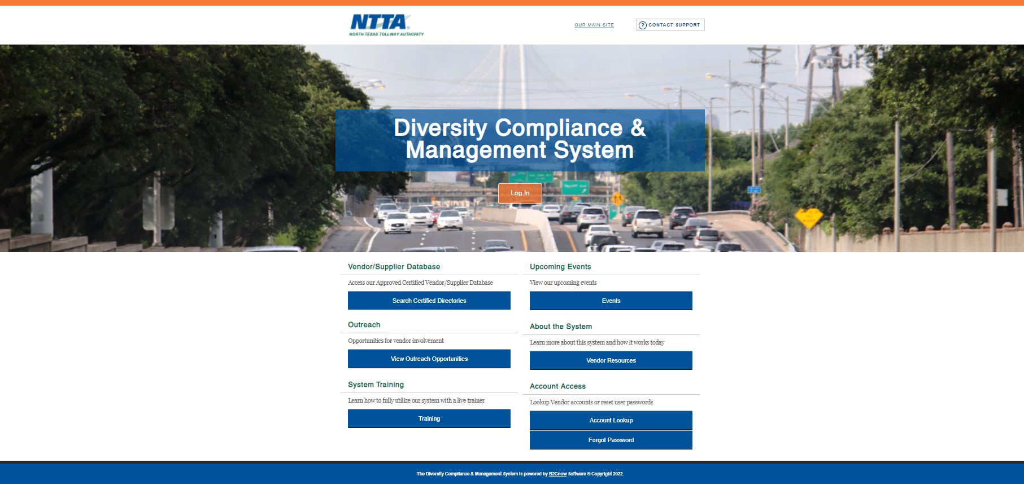








Recognized Certification Agencies
MBE and WBE certifications
To gain access to D/M/WBE List (maintained by a third party): https://ntta.diversitycompliance.com/
DBE certification only
To request a list of available D/M/WBEs from Business Diversity:
businessdiversity@ntta.org
Include NAICS or NIGP codes
Scope description
Notes:
These are the certifications NTTA recognizes in our D/M/WBE program. If you are using a firm that does not have one of these certificates it means you may use them but their participation will not count towards the minority aspirational goal. To further assist you in being successful and understanding NTTA’s policy on Business Diversity and the role of the Business Diversity at Department the following are resources you may review.
MOVE TO FINAL SLIDE 10 D/M/WBE Resources

Slide 21
Supplier Participation Options
Manufacturer
If the materials or supplies are obtained from a D/M/WBE manufacturer, count 100% of the cost of the materials or supplies towards the goal
Regular Dealer
If the material or supplies are purchased from a D/M/WBE regular dealer, count 60% of the cost of the materials or supplies toward the goal
Broker
If the D/M/WBE firm is acting as an intermediary between two or more firms for the acquisition of supplies, materials or equipment for a fee, count only the fees and commissions at 100%
Manufacturer’s Representative
If the D/M/WBE firm is representing a manufacturer for a fee or commission, count only the fees and commissions at 100%

Slide 22

Who is Required to Complete the Form(s)?
All primes with or without minority certifications.
Prime is a Prime.
Notes:
Again, “A Prime is a Prime”. The Prime is responsible for the contract and is the one that has entered into a contractual agreement with NTTA.
A Prime large or small, minority or non-minority a Prime is a Prime.
If you are a minority Prime your participation as a Prime minority counts towards the overall agency attainment but it DOES NOT COUNT TOWARDS THE ASPIRATIONAL GOAL OF THE CONTRACT.
Business Diversity wants the Prime and Subs to be successful. If you need any help with completing the forms, do not hesitate to contact us. All your questions should be channeled through the buyer and we will gladly help.
We CARE about your success…with that comes some responsibilities on your part.
Go into the explanation of CARE. Slide 8

Slide 23
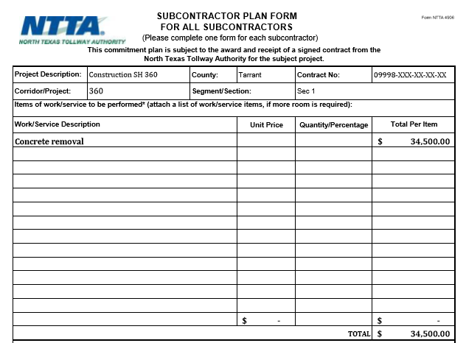
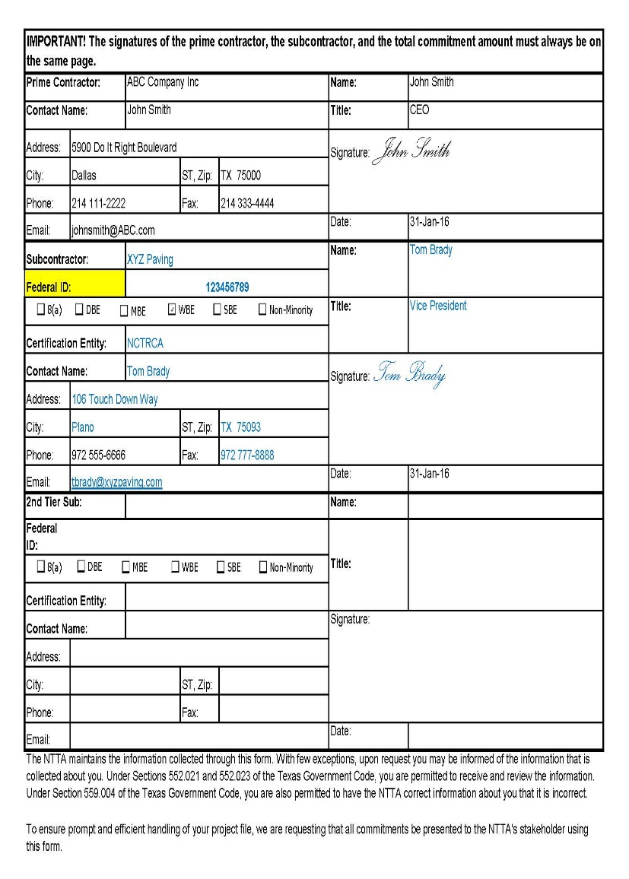
Subcontractor Plan Form
Upper Half of the Form
Lower Half of the Form
Completed by the prime contractor
One form for each subcontractor
Provide a work/service description
Ensure dollar amount and/or percent of contract is recorded on each form
Complete prime and subcontractor information (contact info)
Ensure subcontractor’s Federal ID number is listed
List certification status of each subcontractor
Signature of both parties included
Notes:
A numerical goal has been assigned to this solicitation. This means that a Prime Bidder you MUST complete a 4906 form identifying all the firms you are planning on using on the contract both minority and non-minority.
A subcontractor is a subcontractor, regardless of the certification(s). This information is also helpful because a Prime must do a certain part of the work to be considered a Prime.
The form also tells us the following information:
Who the Prime is,
what the agreed upon contract value and scope of services to be provided by the subcontractor is,
whether the subcontractor is a minority or not etc.
As mentioned earlier, “A subcontractor is a subcontractor” and equally, A Prime is a Prime” regardless of its certification status. We say that, because with being a Prime comes a few other responsibilities. The Prime is responsible for completing all the necessary forms that BDD/ NTTA requires.
Move to Slide 7 “Prime is a Prime”

Slide 24
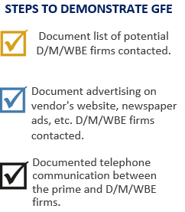

Good Faith Effort Form
Section “B” has all the back-up requirements for an approved GFE
Please note:
The Business Diversity Department will verify information submitted.
page one
page two
Notes:
This contract has a Good Faith Effort Goal on it. This is not a numerical goal but a goal to demonstrate your efforts as a PRIME to look for opportunities on the contract that may be performed or supplied by a D/M/WBE firm. We are not suggesting that you incur additional costs by utilizing a D/M/WBE firm if the work that could be performed by a D/M/WBE firm is work that is part of your normal business practice and utilizing a D/M/WBE firm would increase costs clearly state and provide as much detail in your explanation. Marking up the GE with N/A or “we do not subcontract” is considered non-responsive and may require additional work on your part. We are encouraging you to look for potential opportunities that make good business sense. The best way to demonstrate your Good Faith Effort is to do any and or all of the following MOVE TO SLIDE 6 DEMONSTRATING GOOD FAITH EFFORT

Slide 25




Still Need Help?
D/M/WBE questions?
Request for DMWBE List
Email: businessdiversity@ntta.org
D/M/WBE List (maintained by a third party)
https://ntta.diversitycompliance.com/
Business Diversity Contracting & Compliance Manual
D/M/WBE Compliance Reporting Forms
https://www.ntta.org/procurement/business-diversity
https://www.ntta.org/procurement/busdiv/complianceandresources/Documents/2019/BusinessDiversityDepartmentContractingComplianceManual.pdf
Notes:
These are the certifications NTTA recognizes in our D/M/WBE program. If you are using a firm that does not have one of these certificates it means you may use them but their participation will not count towards the minority aspirational goal. To further assist you in being successful and understanding NTTA’s policy on Business Diversity and the role of the Business Diversity at Department the following are resources you may review.
MOVE TO FINAL SLIDE 10 D/M/WBE Resources

Slide 26
SCOPE OF WORK

Slide 27
Scope of Work
The North Texas Tollway Authority Maintenance Department is seeking to contract for facility janitorial services at four (4) occupied buildings and five (5) single use restroom facilities.
  All cleaning supplies and equipment required for cleaning shall be included in the base price for cleaning.
  Personnel are required to be appropriately dressed at all times while working on the property, including OSHA required personal protective equipment.
  Qualified bidders must have sufficient local operations to support the desired service levels at all sites included in this solicitation.

Slide 28
Scope of Work
The MLP 3 Office Complex at 2803 Dallas Parkway, Plano, Texas 75093 a one-story building with Mezzanine, and tunnel cleanable square footage of 7,083 square feet.
The MLP 4 Office Complex at 10350 Dallas Parkway, Frisco, Texas 75034 a one-story building with cleanable square footage of 3,045 square feet.
The Frisco Operations Center (FOC) located at 11110 Research Road, Frisco, Texas 75033 with cleanable square footage of 10,846 square feet.
The Plano Maintenance Center located at 1080 Ohio Drive, Plano, Texas 75093 with a cleanable square footage of 17,393 square feet.

Slide 29
Scope of Work
The five single use restroom facilities are located across the metroplex. Each location is a controlled access single person restroom facility. The size of these locations ranges but each is approximately 100 square feet.
  Sam Rayburn Tollway at I35E – 851 Texas 121, Lewisville, TX 75067
  Sam Rayburn Tollway at Dallas North Tollway – 1601 Dallas Parkway, Frisco, TX 75034
  Sam Rayburn Tollway at Exchange Parkway – 8400 State Hwy 121 S., McKinney, TX 75070
  Dallas North Tollway MLP2 – 15909A Dallas Parkway, Addison, TX 75001
  Addison Airport Toll Tunnel – 4140 Keller Springs Road, Addison, TX 75001

Slide 30
KEY DATES

Slide 31
Upcoming Key Dates
September 23 at 2pm
Site Visit
September 25 at 5pm
Deadline to Submit Questions
October 2 at 11am
Bid Due Date

Slide 32
QUESTIONS?

Slide 33
Adjourn
Thank you for attending the pre-bid conference.
We look forward to receiving your bid.

